Slide 1
VITA Volunteer And Site Coordinator
Application Screen Shots

Slide 2
Service Objectives
Improve customer experience
Reduced wait times
Able to provide feedback
Improve volunteer experience
Go where they are most needed
Able to make suggestions
How:
Improve visibility to open sites (mobile web)
Focus volunteers on sites with capacity and strong client demand (mobile app)
Site Coordinators are key: they must maintain the status of their site in real time to guide volunteers (mobile app)

Slide 3
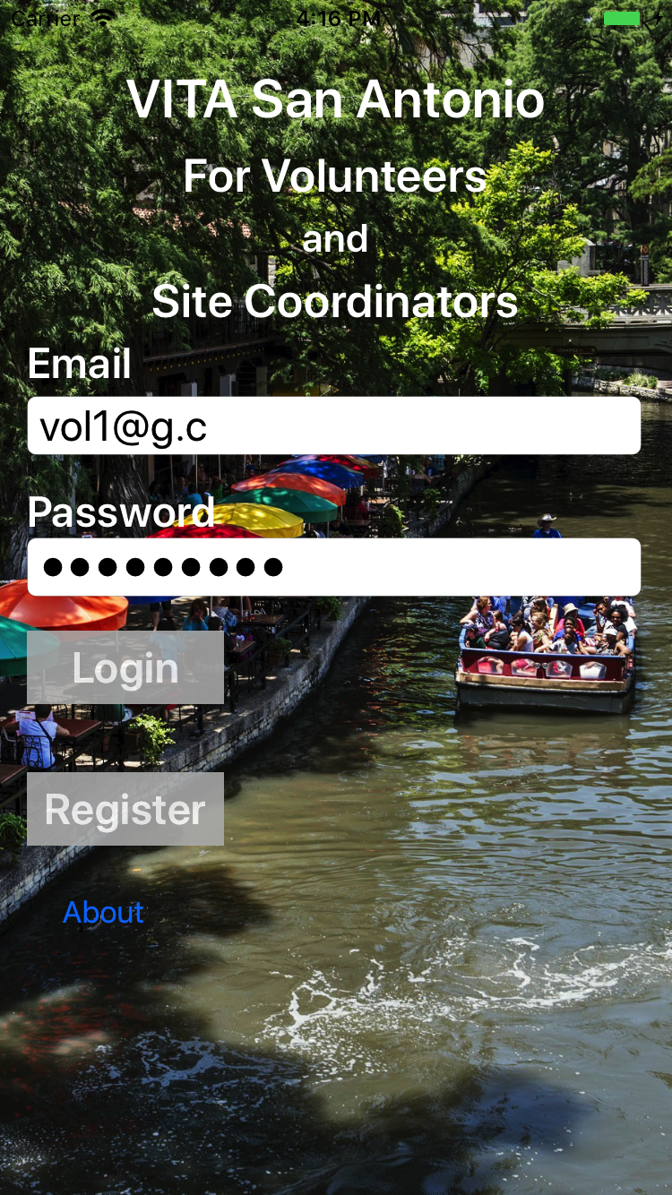
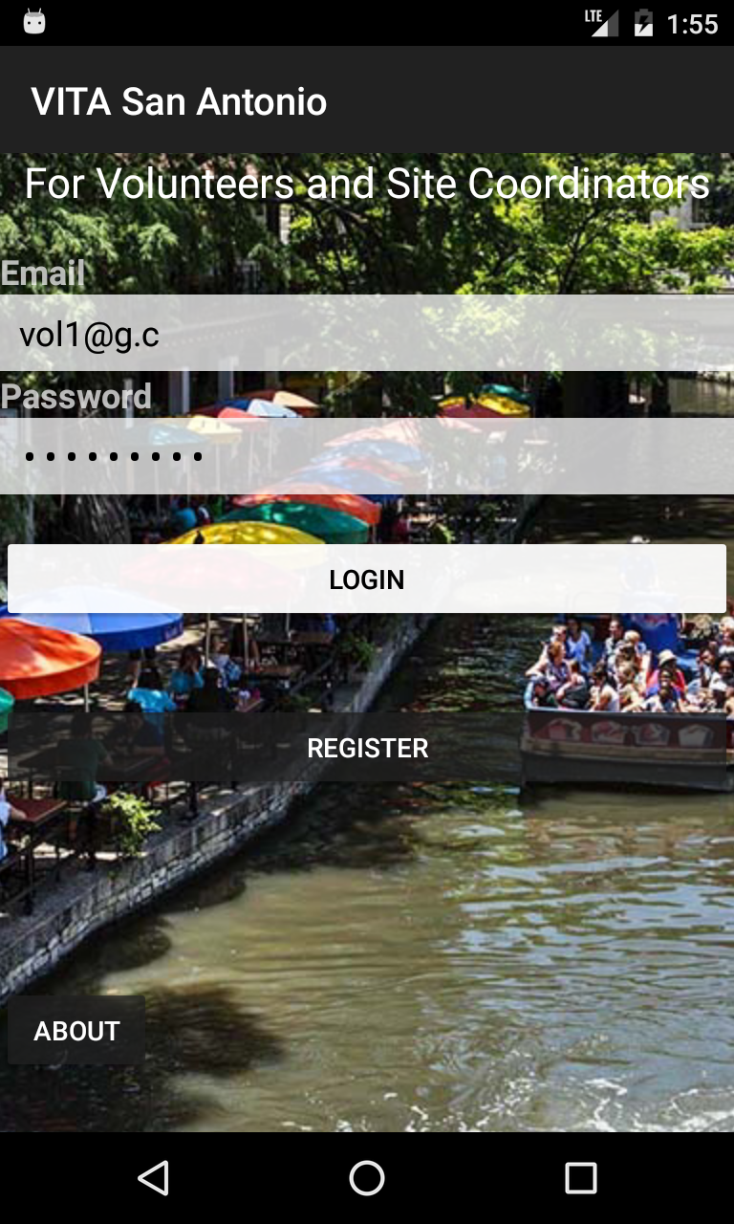
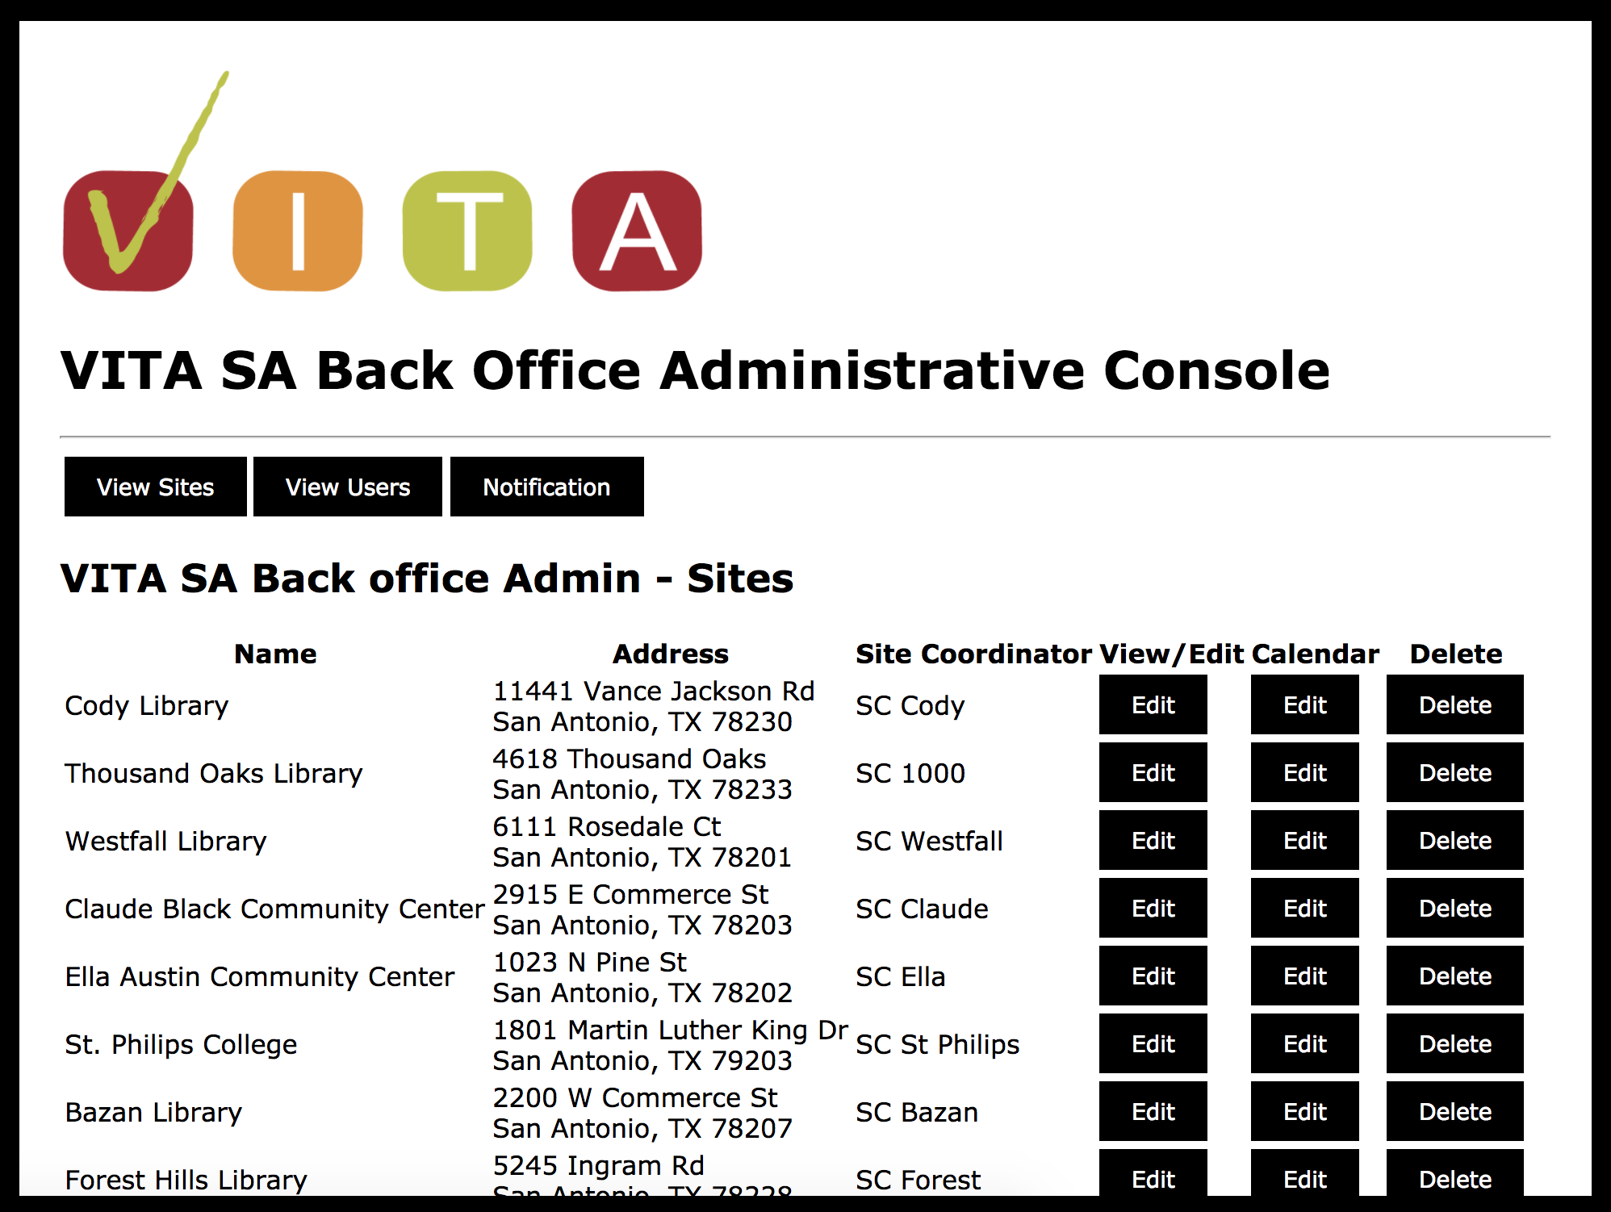
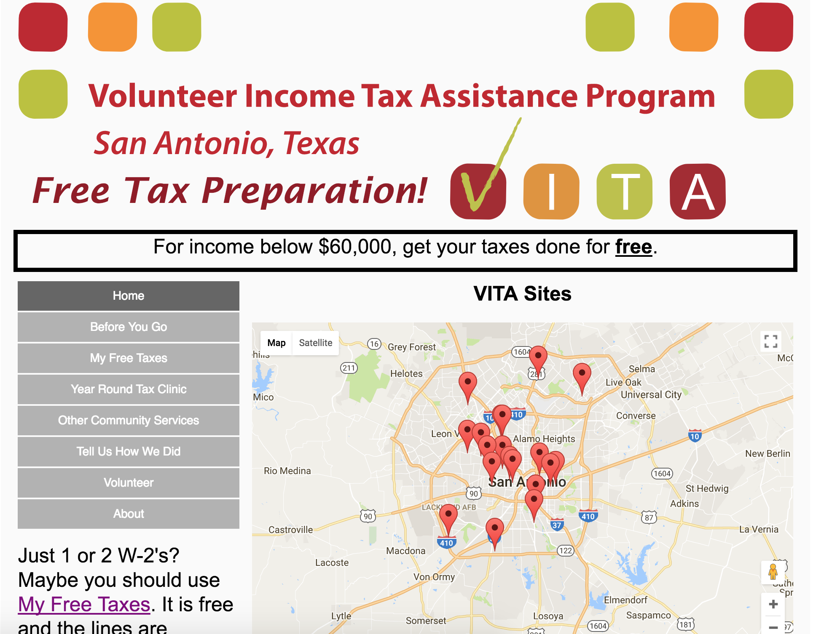
Service Architecture
BackEnd
DB
iOS Devices
Android Devices
vitasa.org
Back office administration
Client web and mobile

Slide 4

Screen Shots

Slide 5
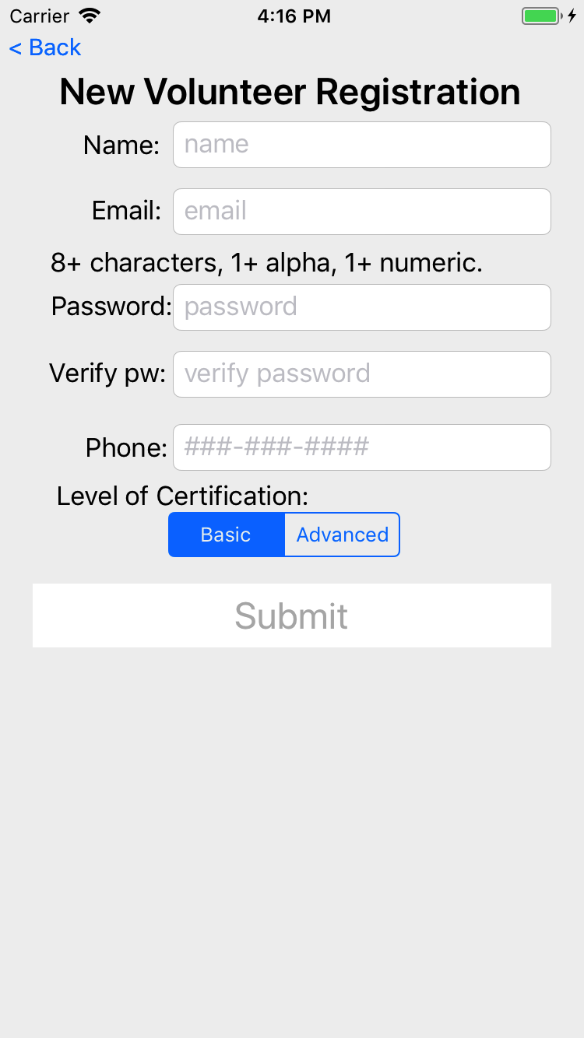
New volunteer registration
Once back office staff approves the user, they can login to the app.

Slide 6
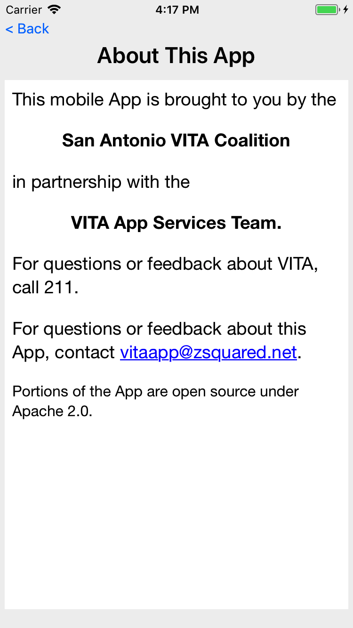
Information about the app.

Slide 7
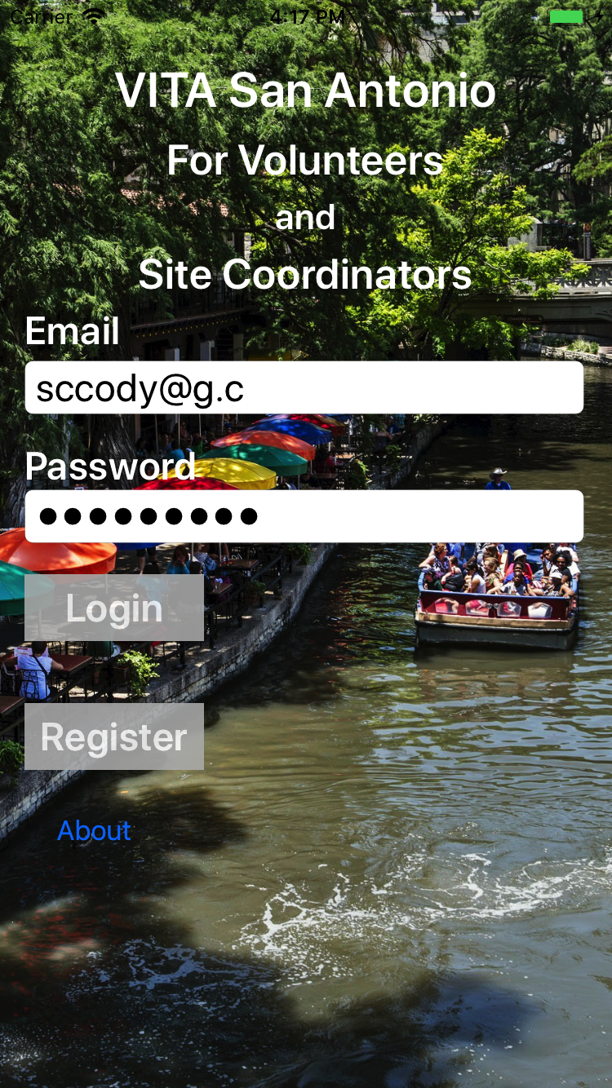
Site Coordinator login

Slide 8
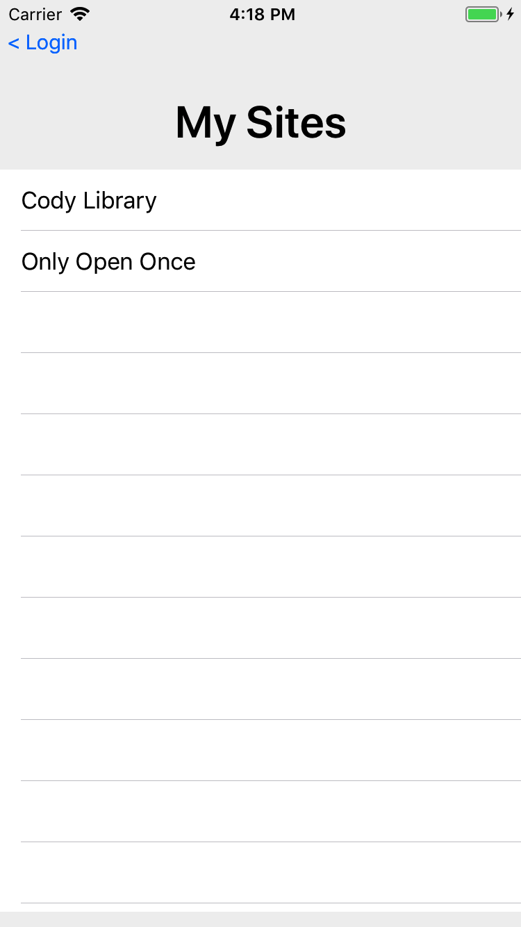
If a Site Coordinator is a primary or backup on more than one site, this screen is shown to determine which site they wish to manage.

Slide 9
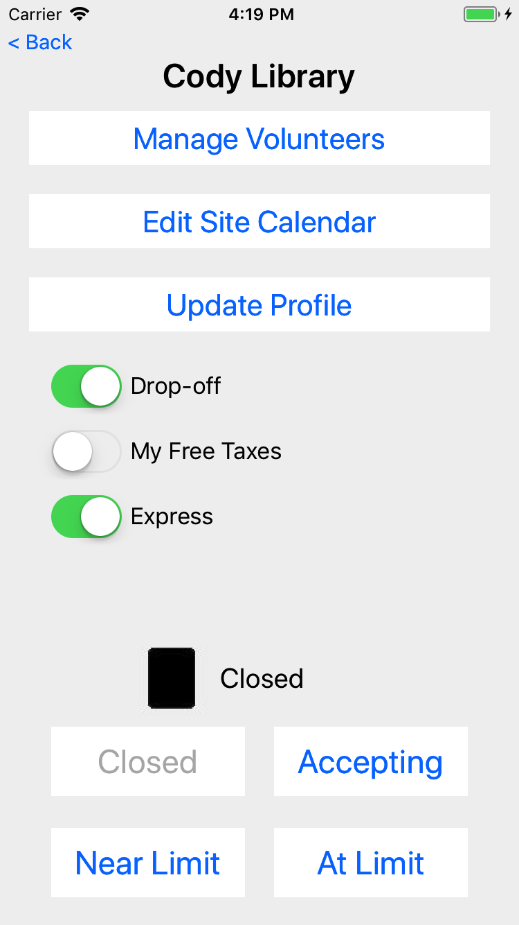
Managing the details for a Site

Slide 10
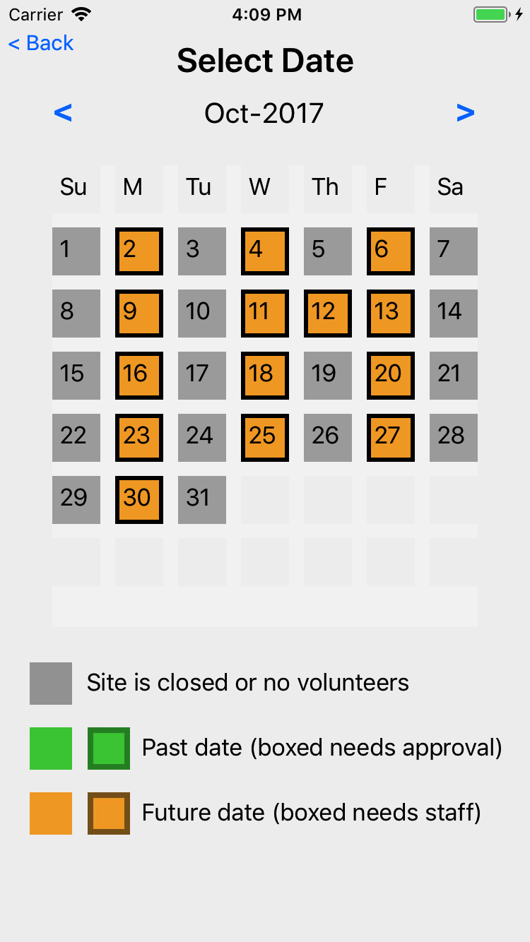
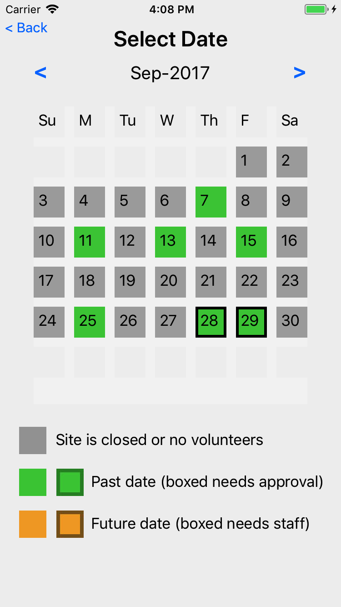
Get a view of volunteers at the site
Green are past dates, boxed for when their hours need approval.
Orange are future dates, boxed when the needed number of eFilers is less than the number signed up.

Slide 11
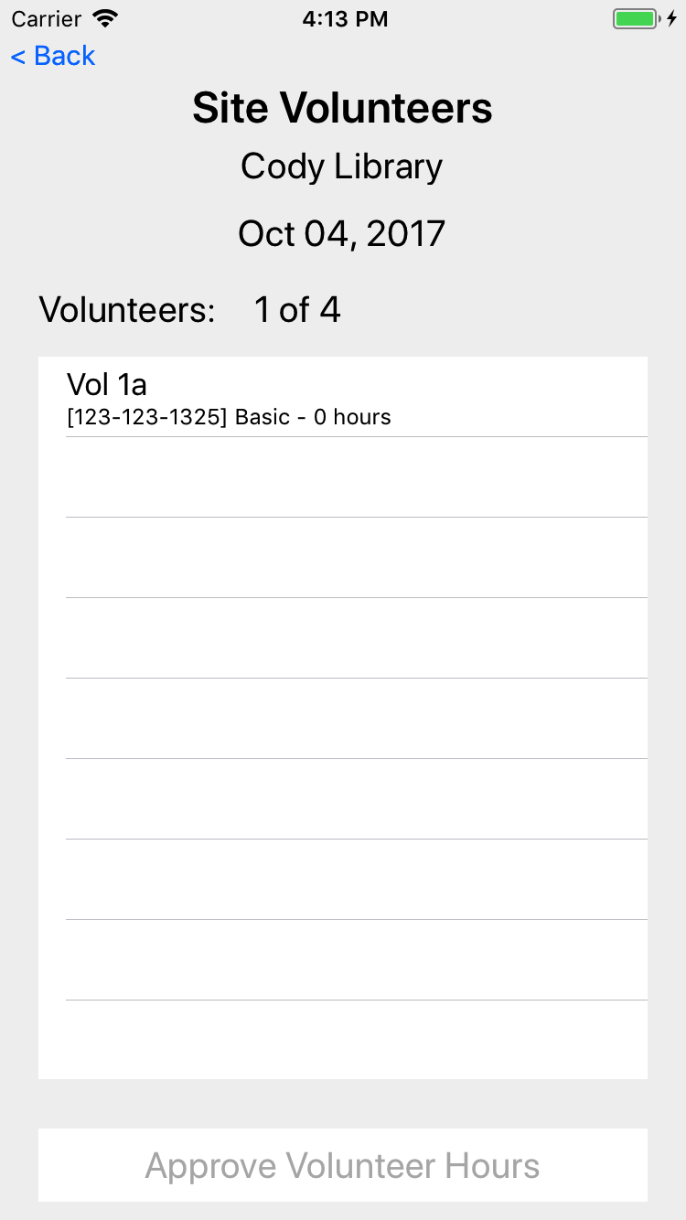
Manage Site Volunteers
See the volunteers for the date
See phone, cert level, and hours
SC can then approve hours for today and past dates

Slide 12
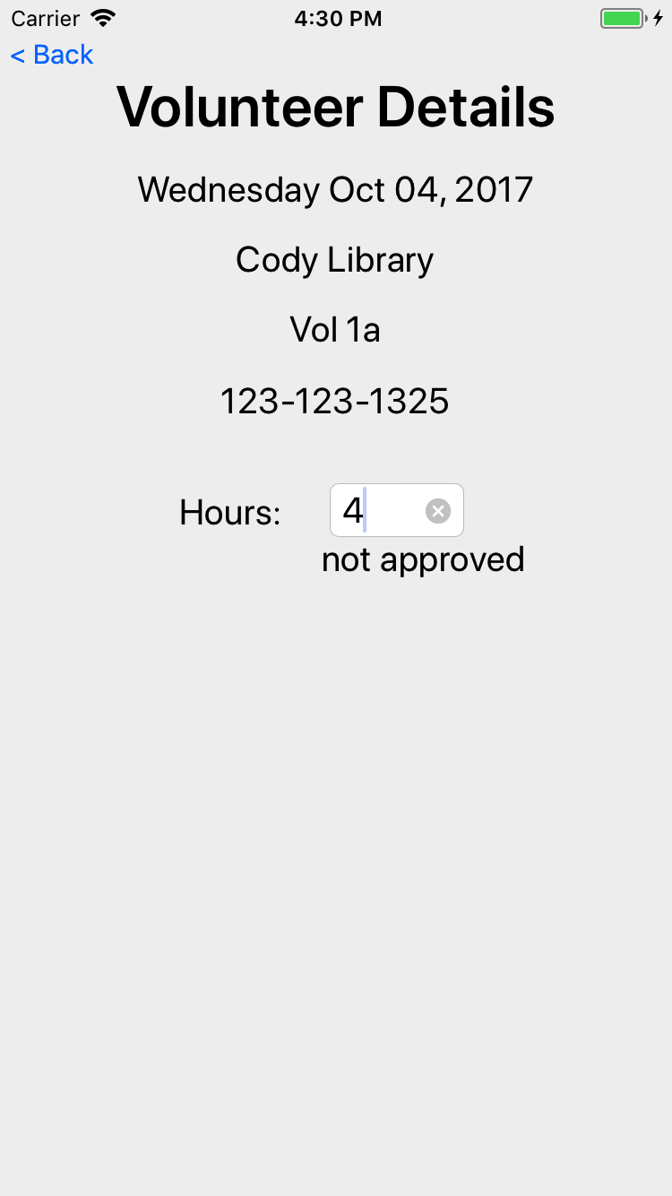
When a user is touched, the SC can adjust the hours (whether approved or not)

Slide 13
Managing the details for a Site

Slide 14
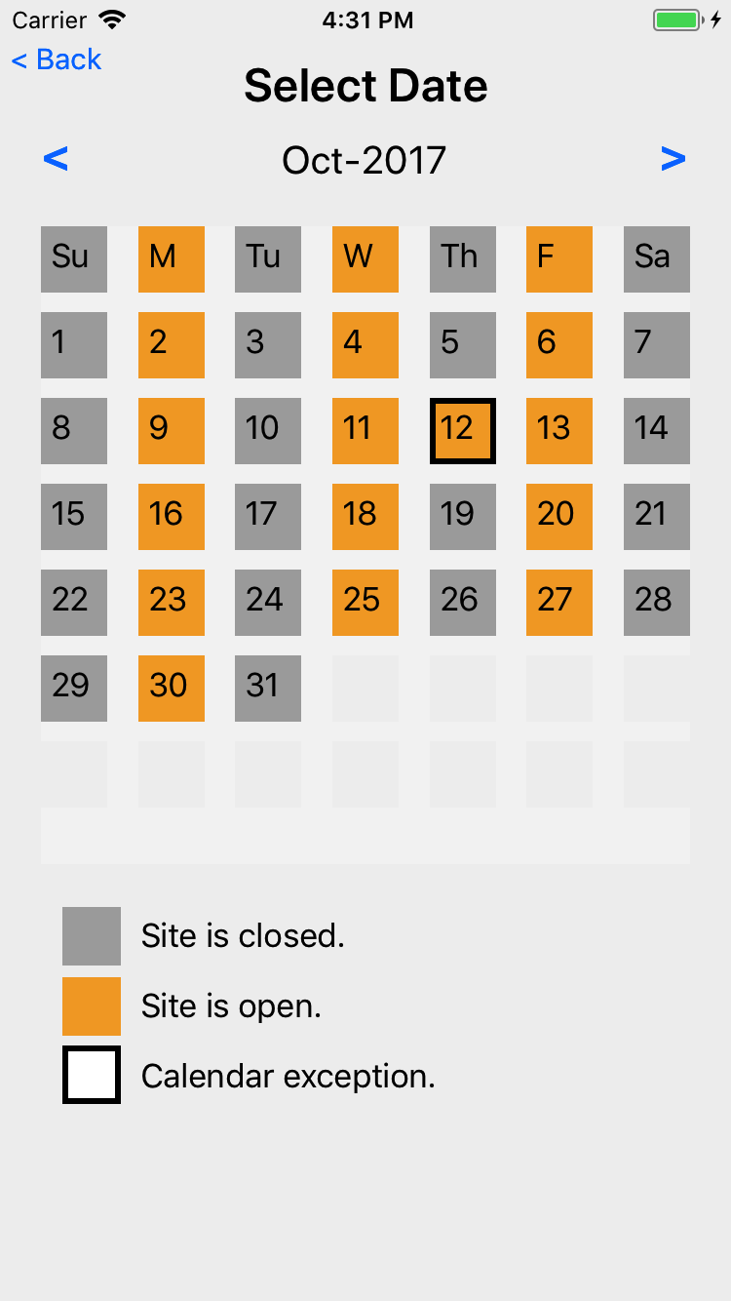
Edit Site Calendar
Touching on top row manages the defaults schedule for each day of the week
Touching a day of week allows edit/change/remove a calendar exception
The open/close for a Site is determined by starting with the defaults, then looking for an exception; if exception found, use the exception

Slide 15
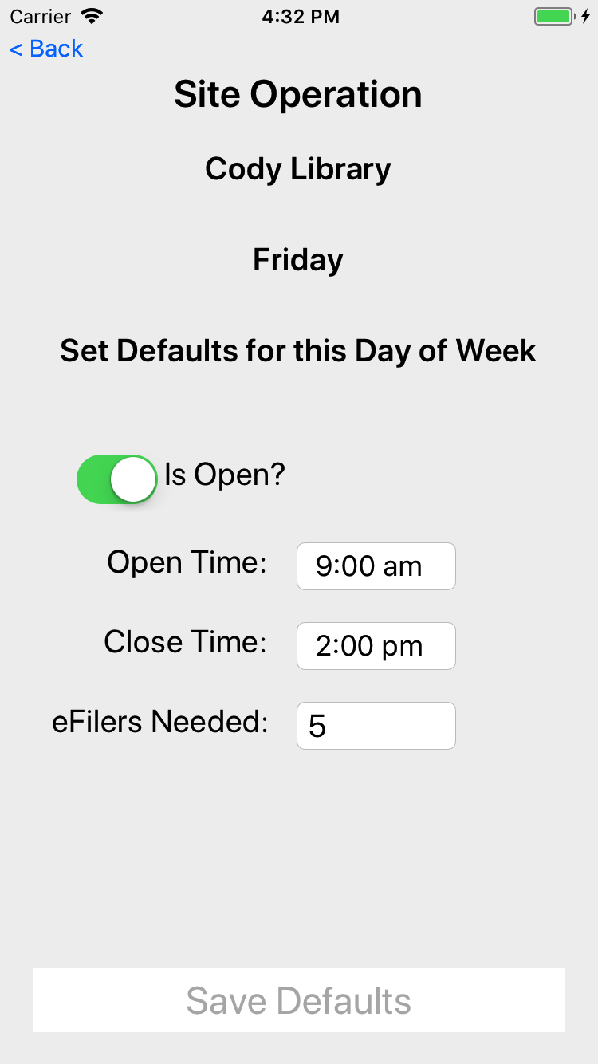
Edit site calendar defaults for each day of the week, Friday as shown here

Slide 16
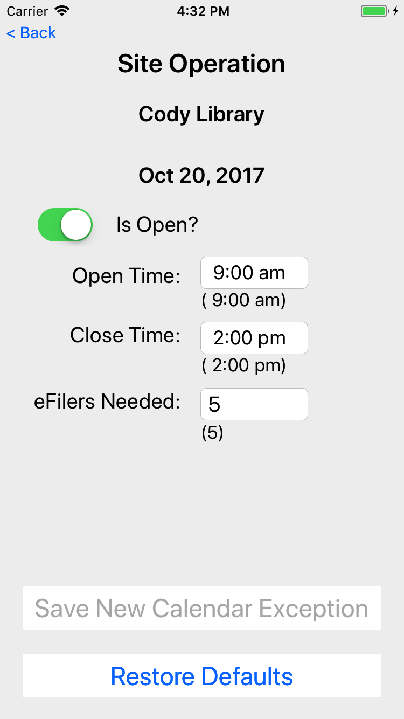
Screen to edit/remove an exception for a given date

Slide 17

Volunteer login

Slide 18
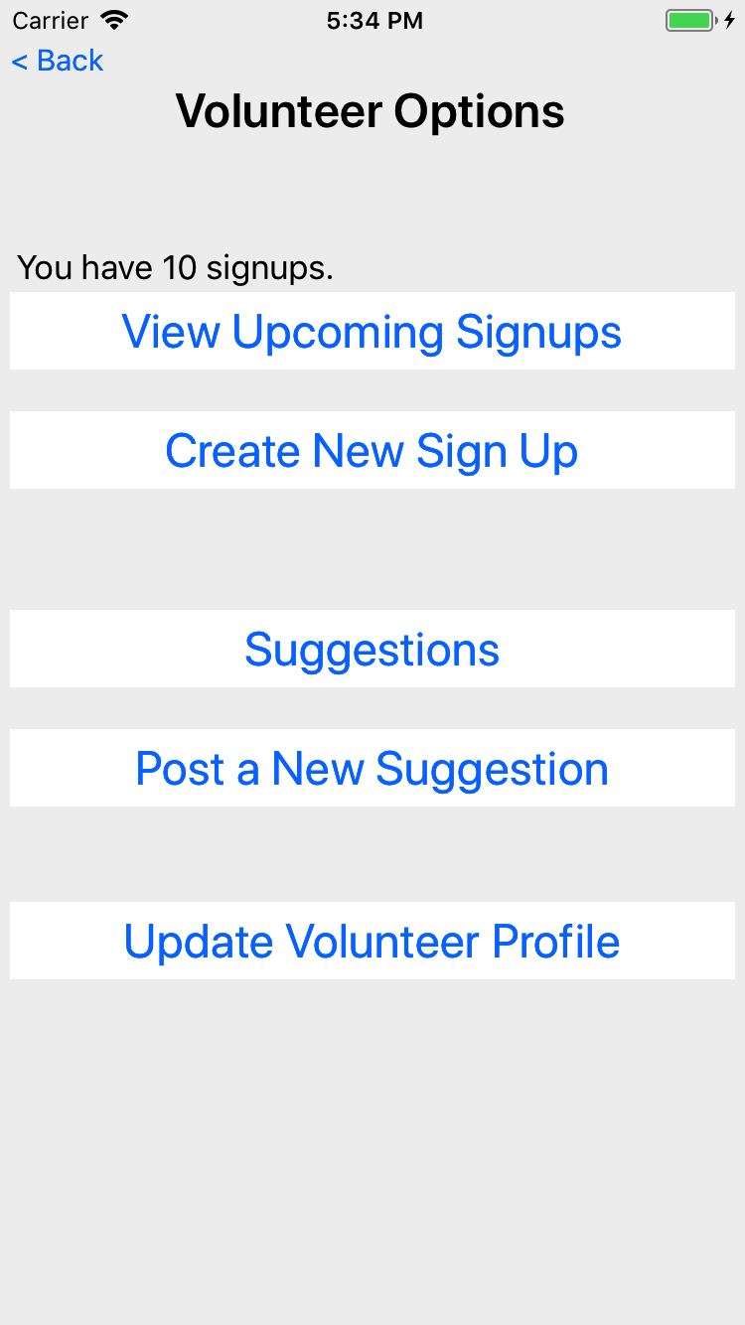
Volunteer options

Slide 19
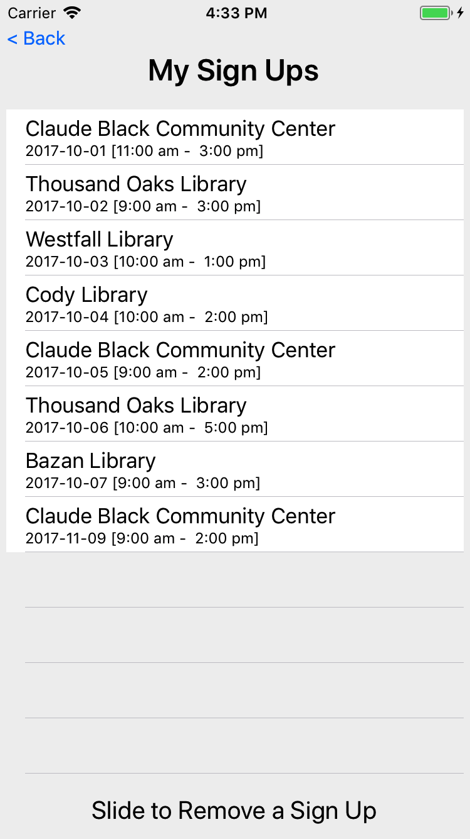
The list of signups for the volunteer, for today and moving forward.
Historical signups are not visible to the volunteer (only the site coordinator)

Slide 20
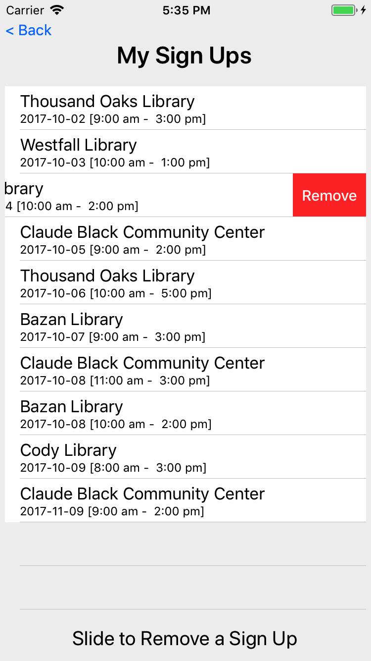

Slide 21
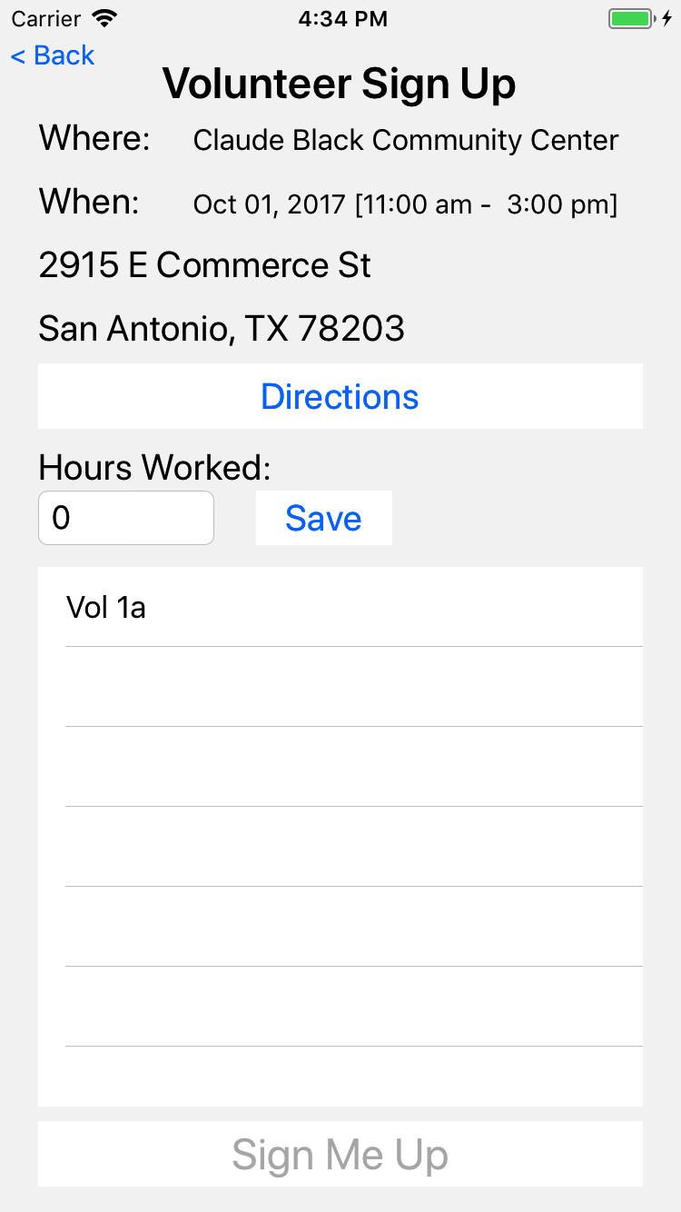
A volunteer can look a their signup, get directions to the site and adjust the hours work.
Hours work can be adjusted by the volunteer until approved by the SC.
The table at the bottom shows other volunteers at the same site on that date.

Slide 22
Volunteer options

Slide 23
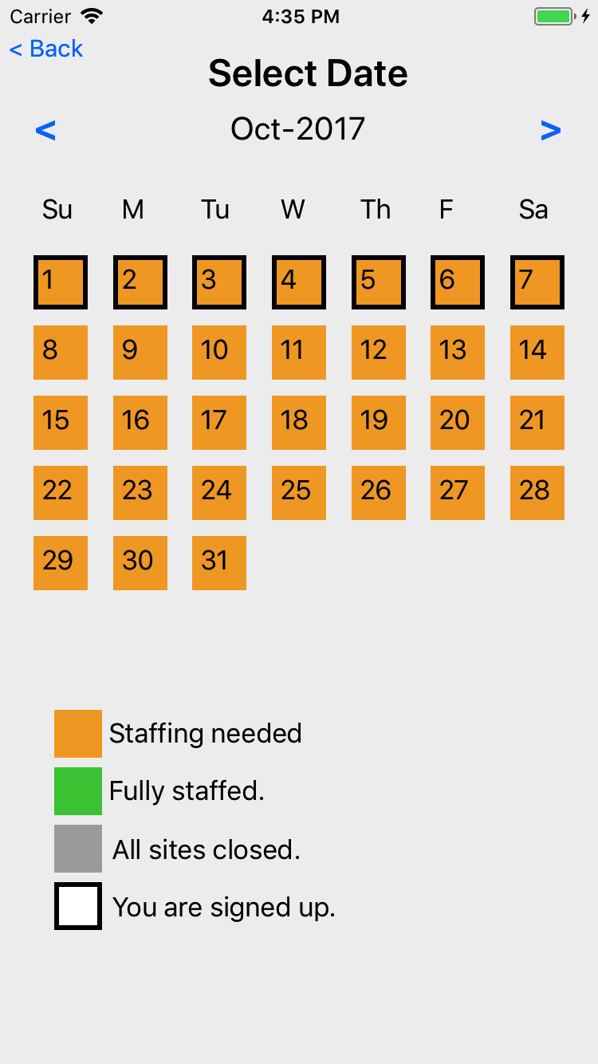
To create a new signup, a volunteer first picks a date.

Slide 24
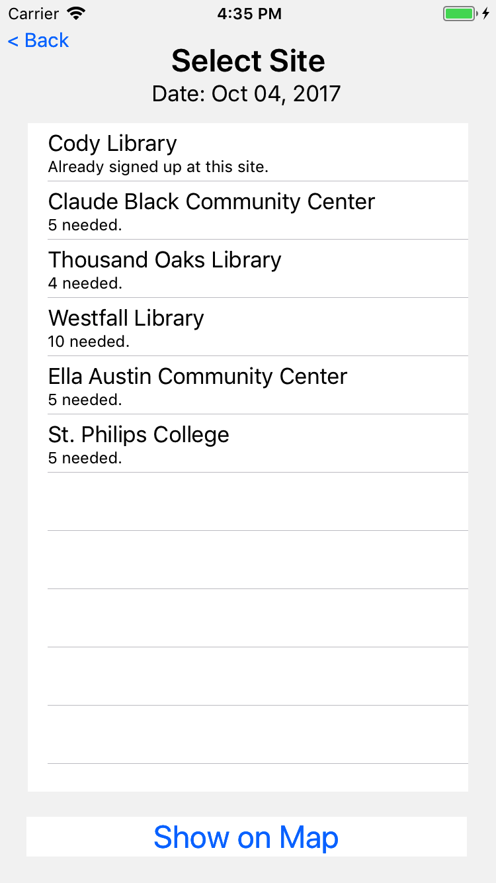
The app then shows sites open on that date that need 1 or more eFilers
If the user happens to be already signed up on that date, that site signup is show.
Mobile team members will be signed up on multiple sites per day.

Slide 25
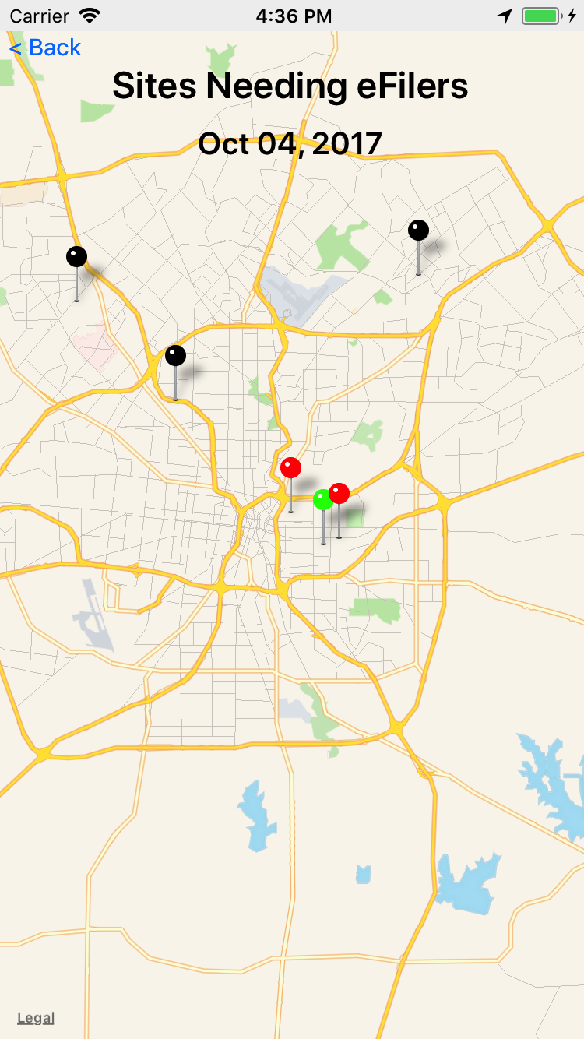
A map of sites needing eFilers
Black is a closed site
Green is a site that has all seats filled
Red is a site that needs help

Slide 26
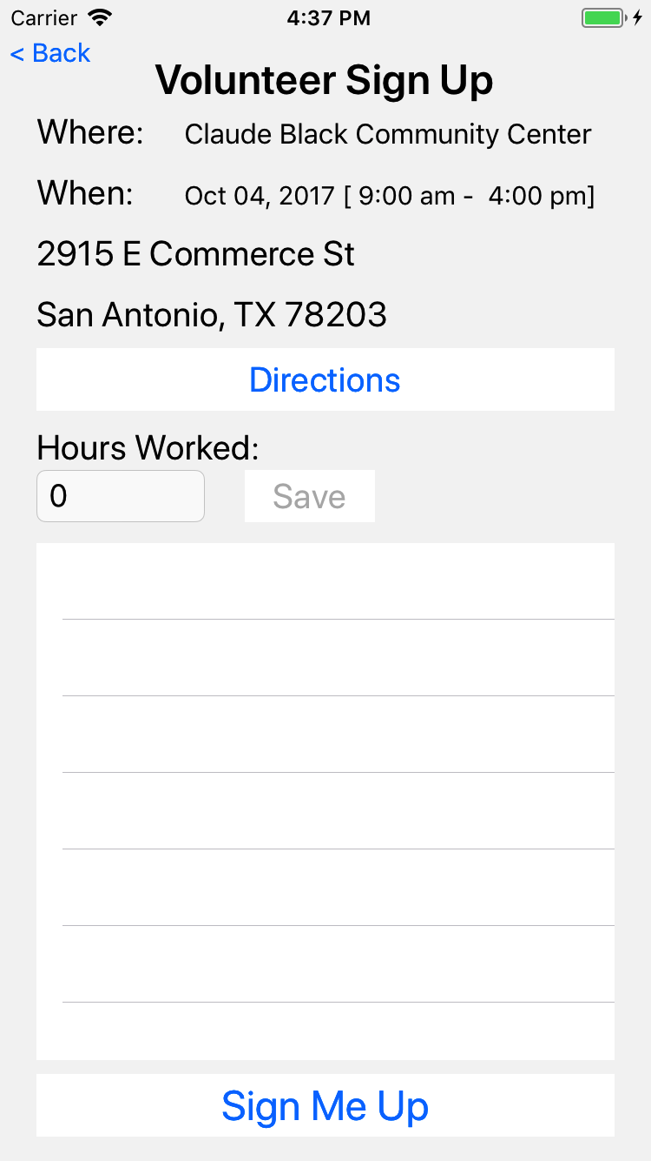
If the volunteer chooses a site, then they get a chance to sign up

Slide 27
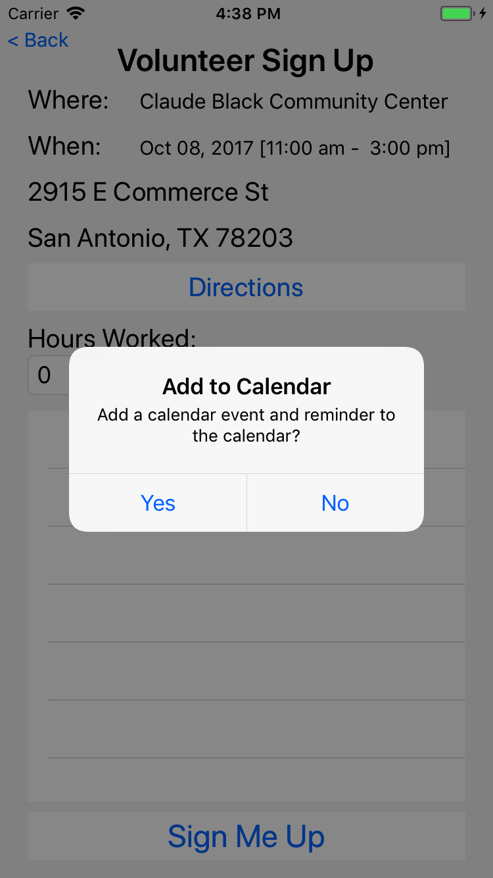
They are given an option to add to their default calendar

Slide 28
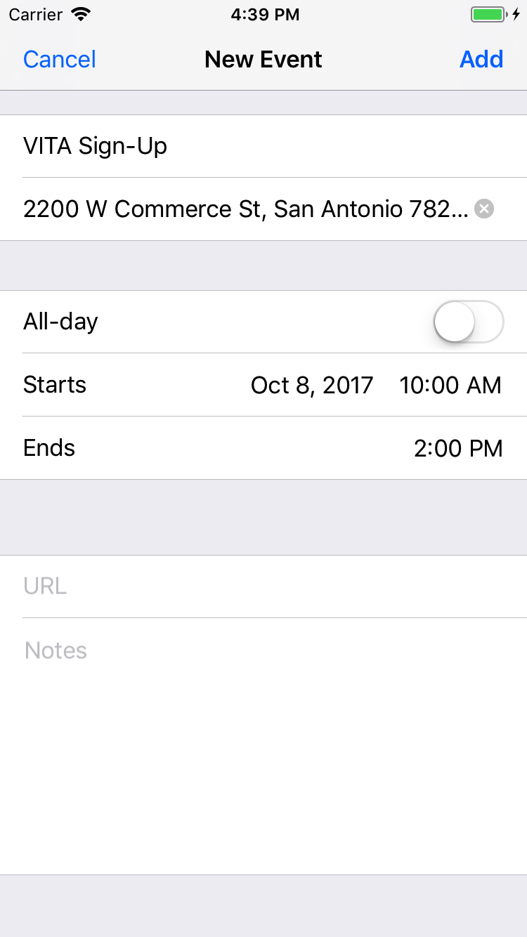
And the ability to modify the calendar event before it is saved in their calendar.

Slide 29
Volunteer options

Slide 30
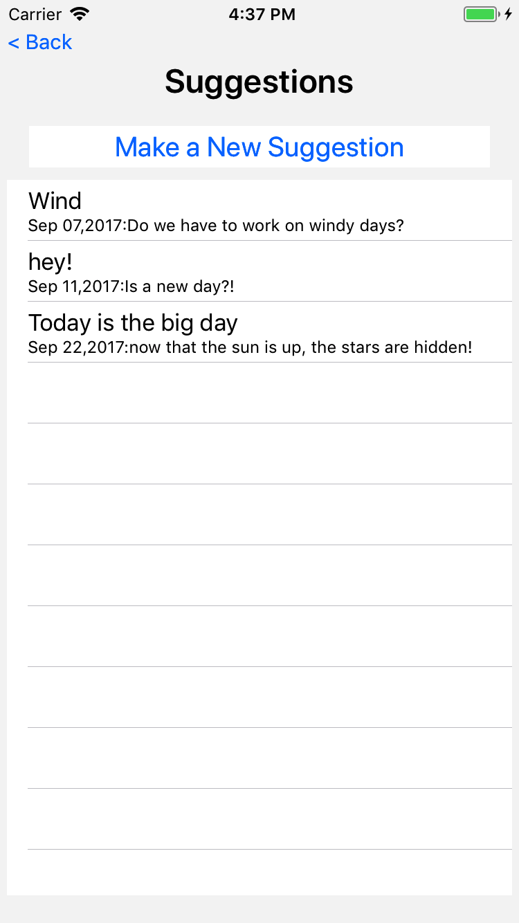
Volunteers can make suggestions.
Here is a list of suggestions from this user.

Slide 31
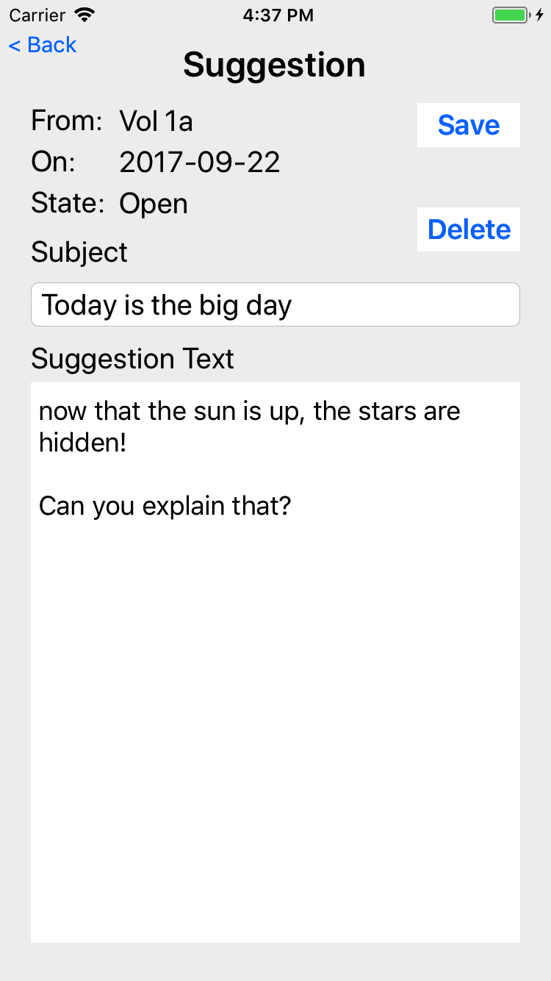
Touching a suggestion allows the user (that submitted the suggestion) to view
The user can make changes until the suggestion is read by the committee; after that, the user can only view the suggestion

Slide 32
Volunteer options

Slide 33
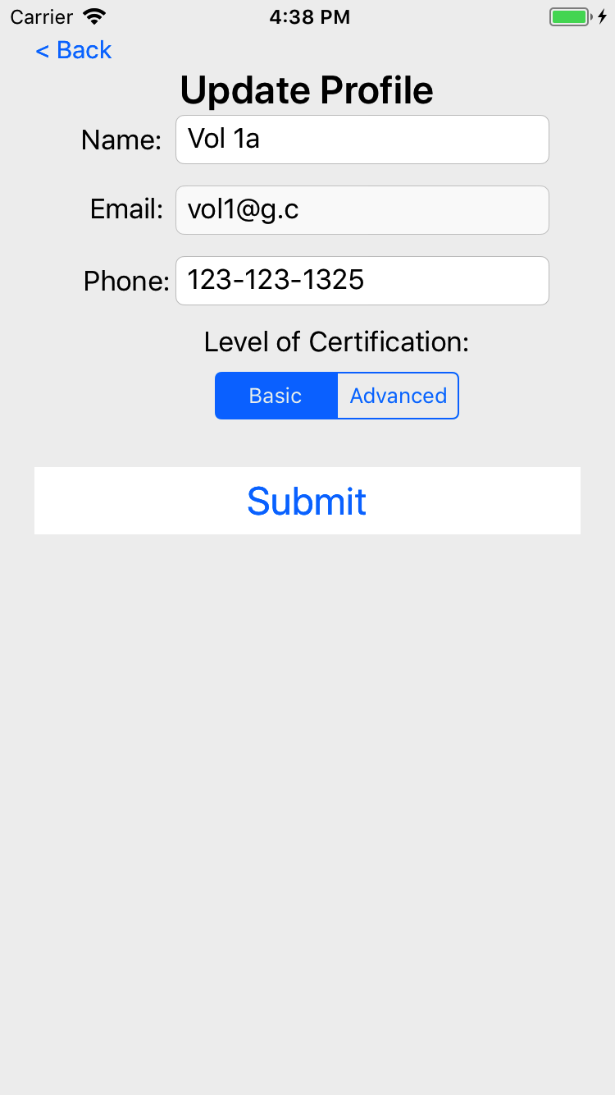
The volunteer can edit their name, phone, and certification but not their email

Slide 34
Not shown
Back office staff can send notifications to volunteers and/or site coordinators

Slide 35
Android Screen Shots

Slide 37
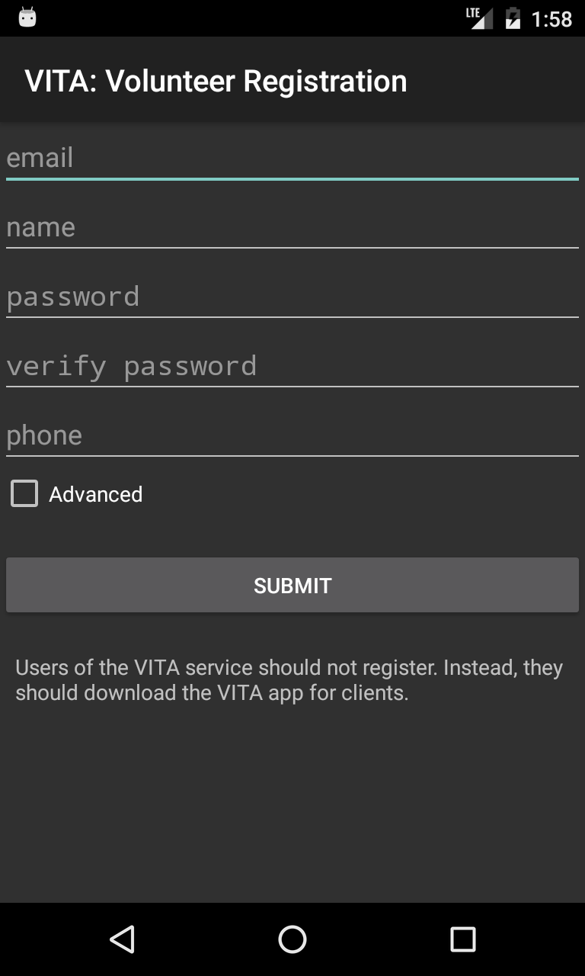

Slide 38
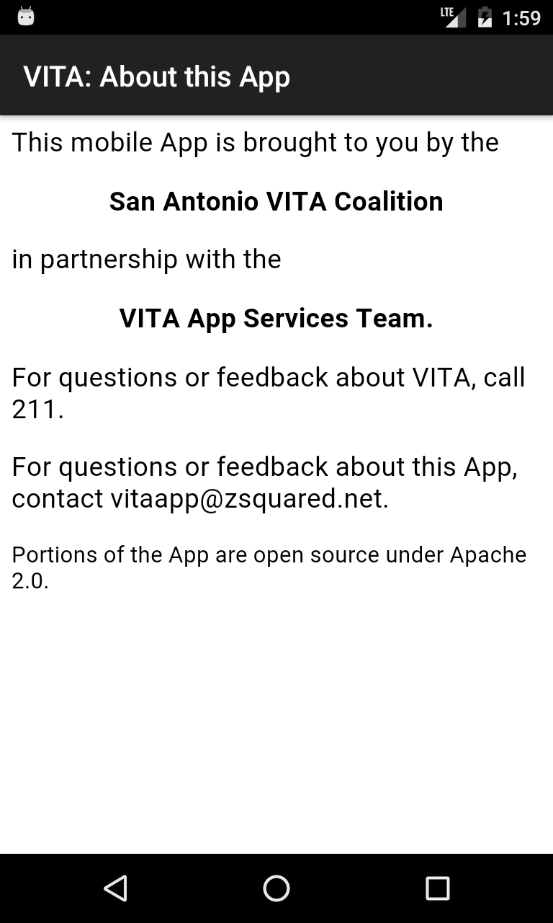

Slide 39
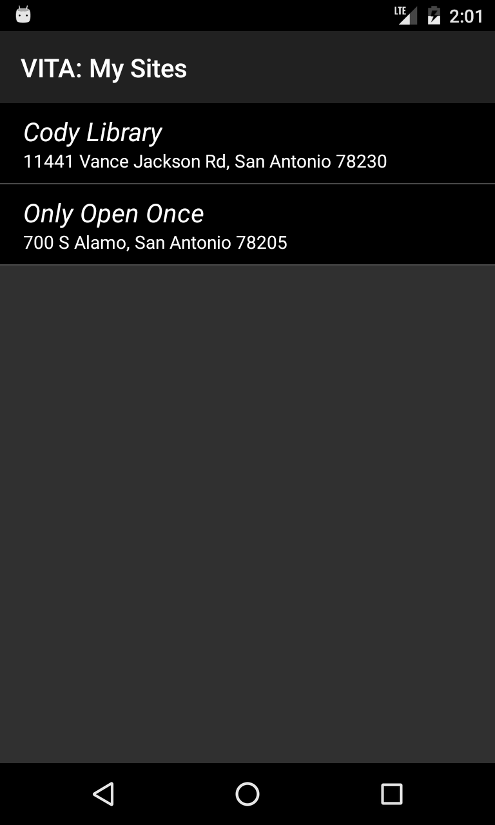

Slide 40
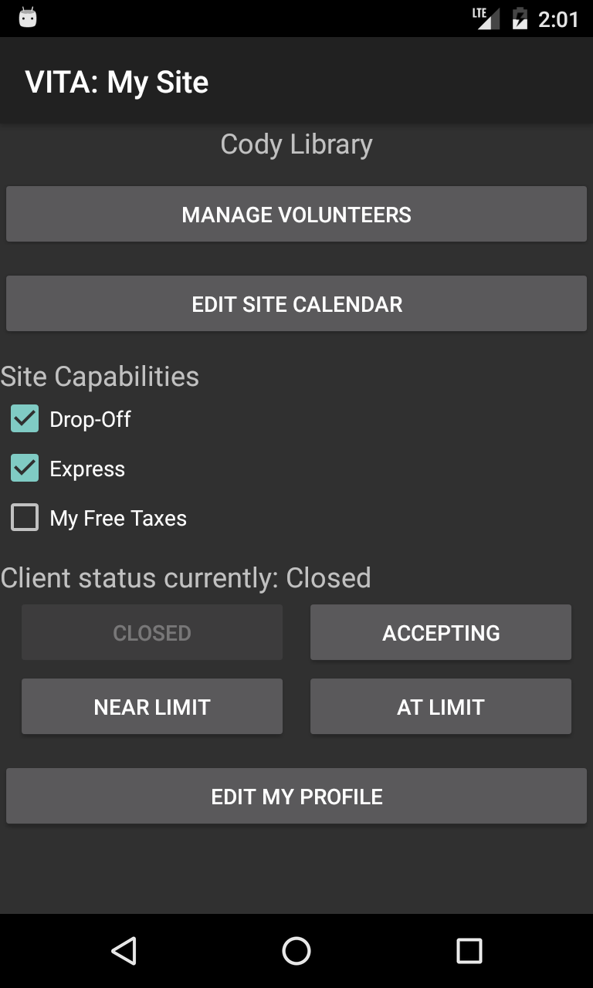

Slide 41
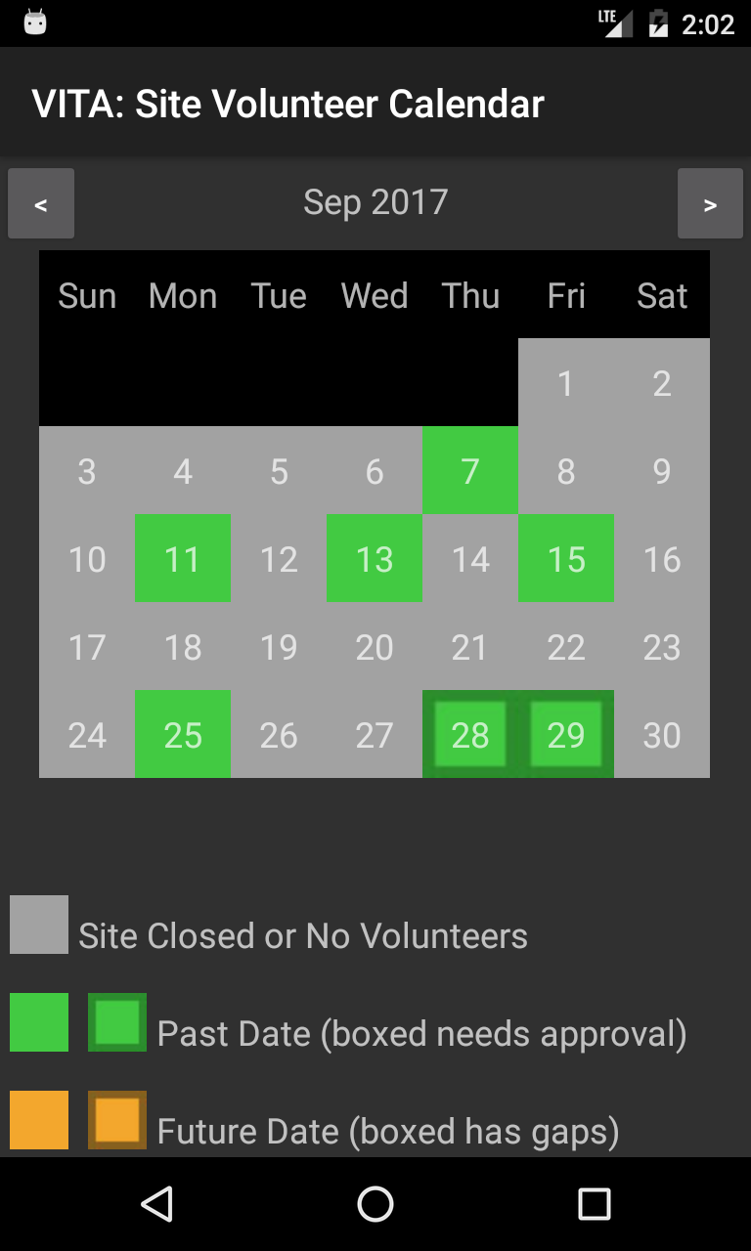
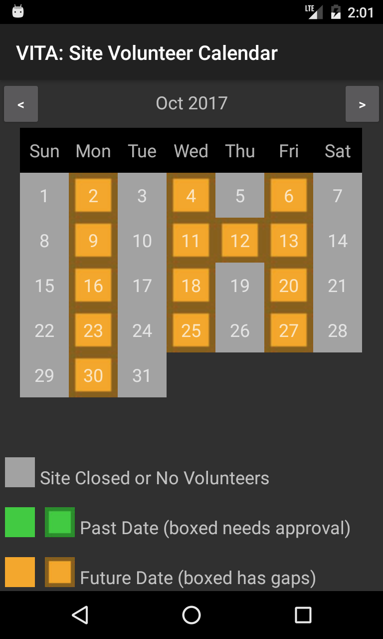

Slide 42
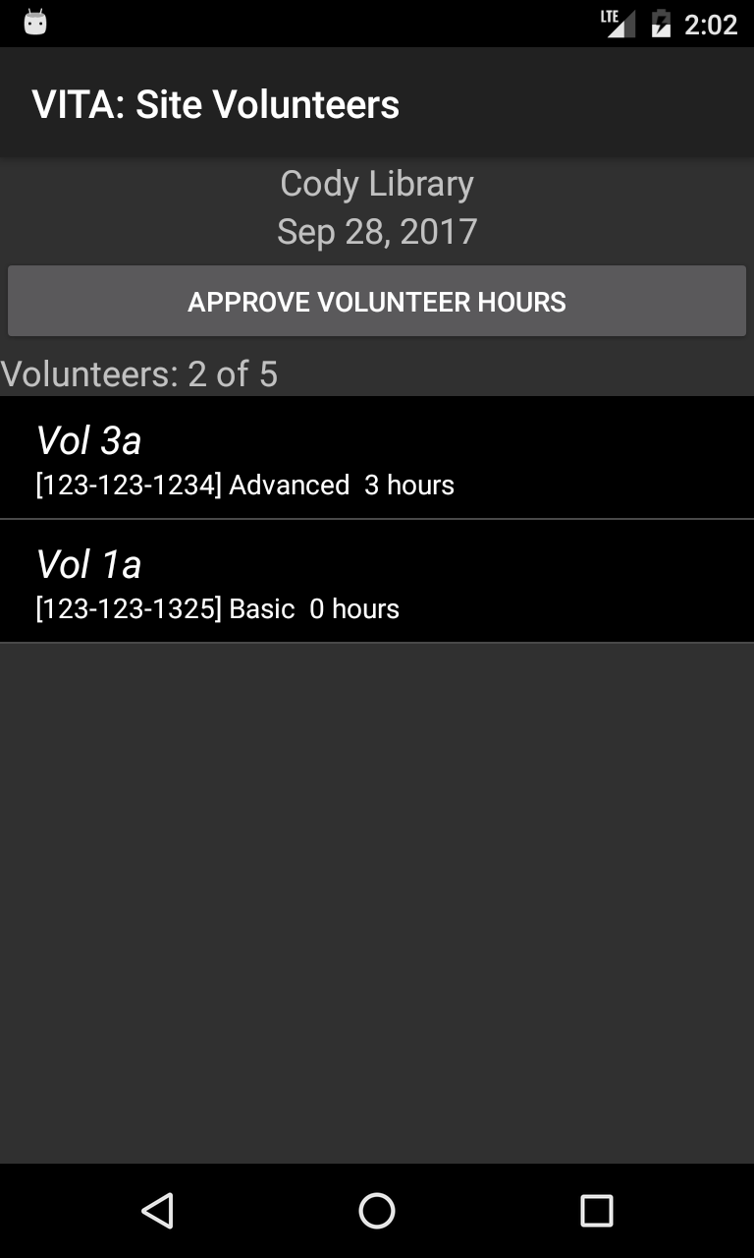

Slide 43
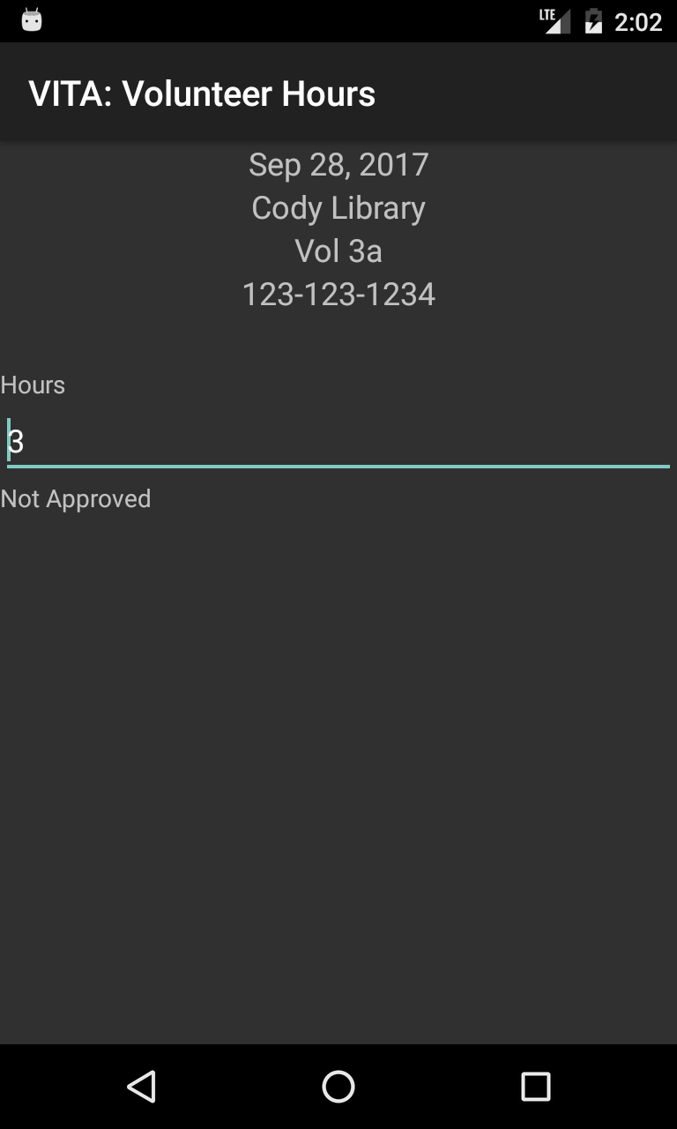

Slide 44
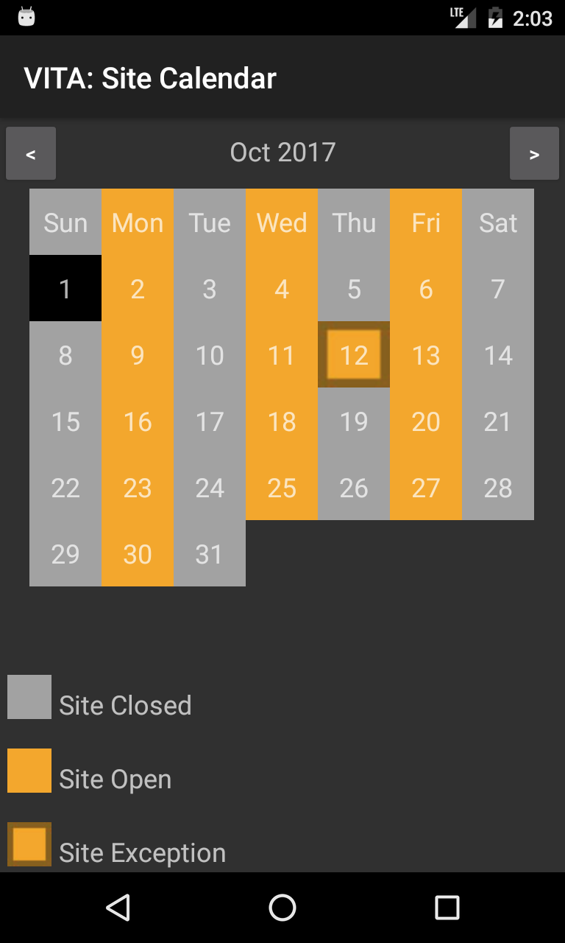

Slide 45
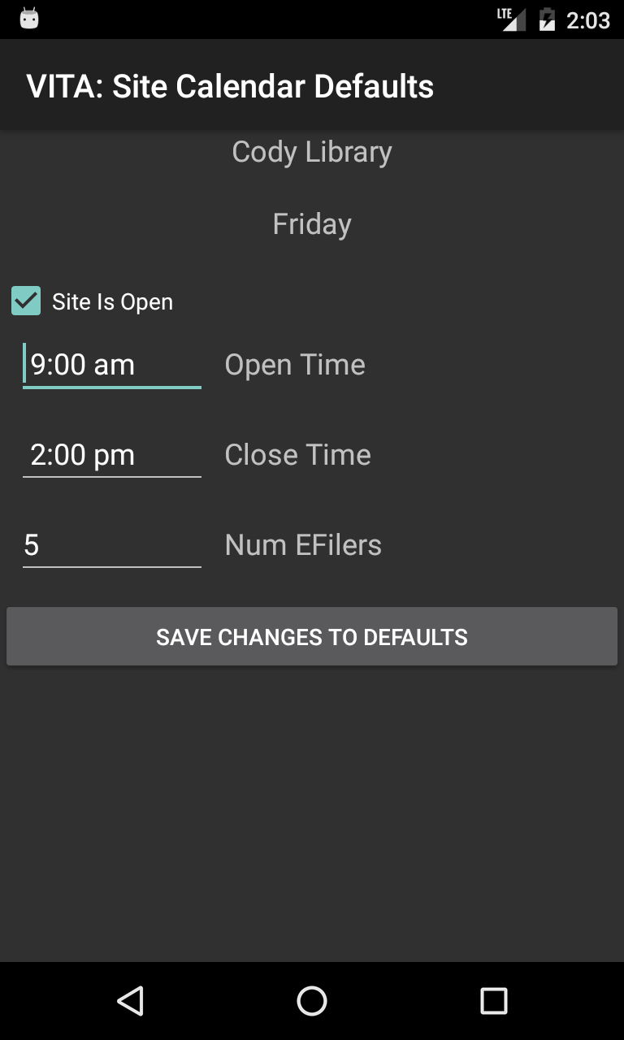

Slide 46
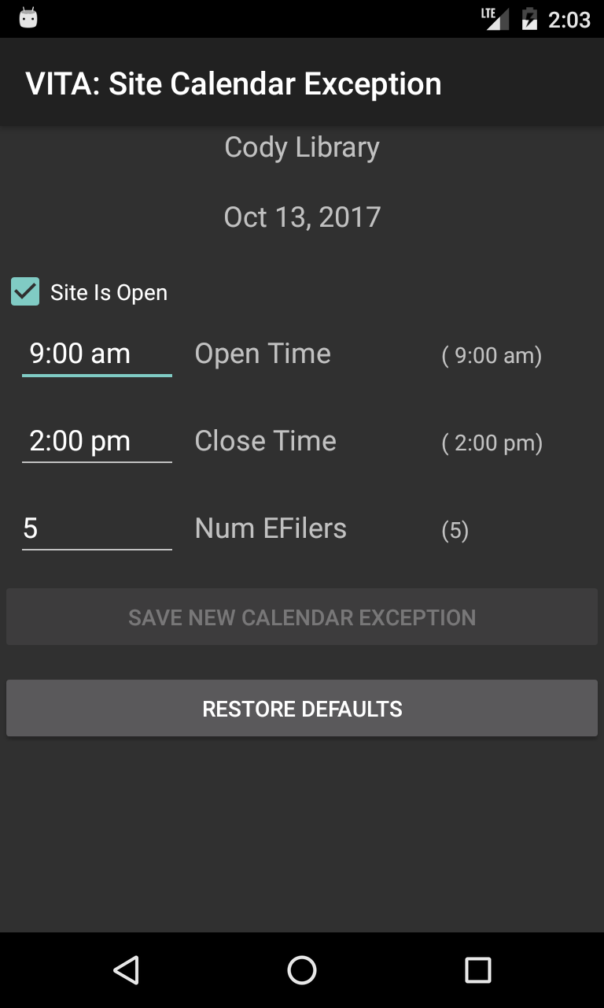

Slide 47
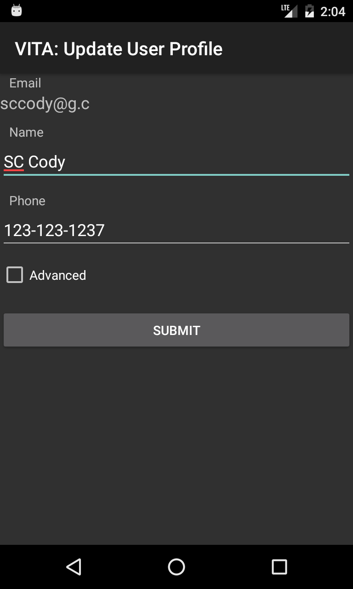

Slide 48


Slide 49
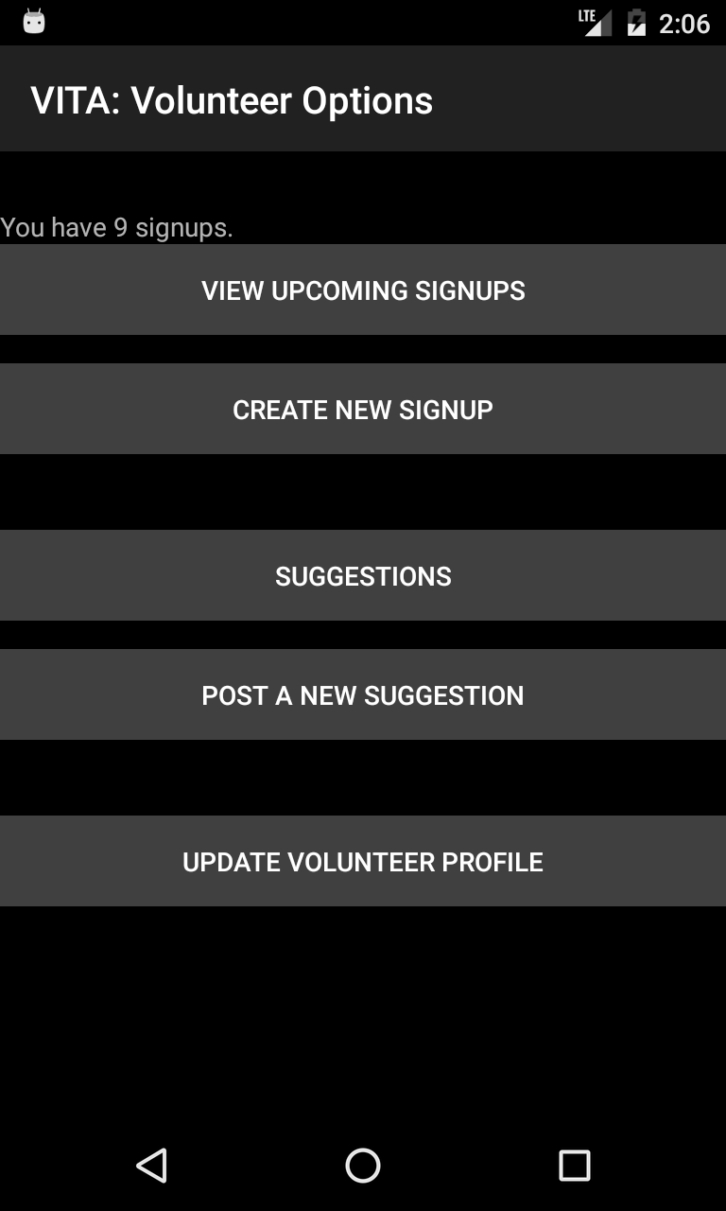

Slide 50
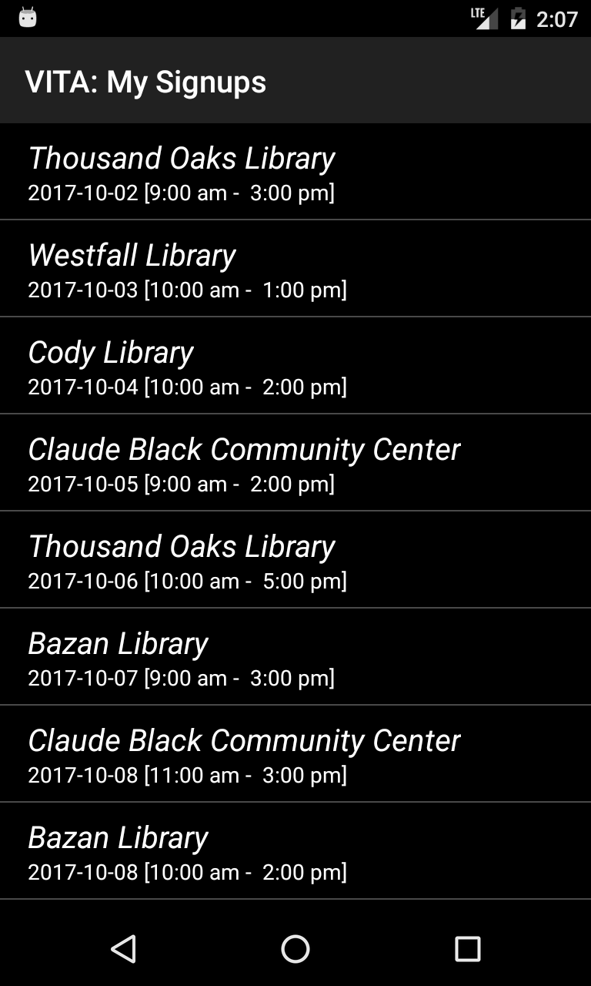

Slide 51
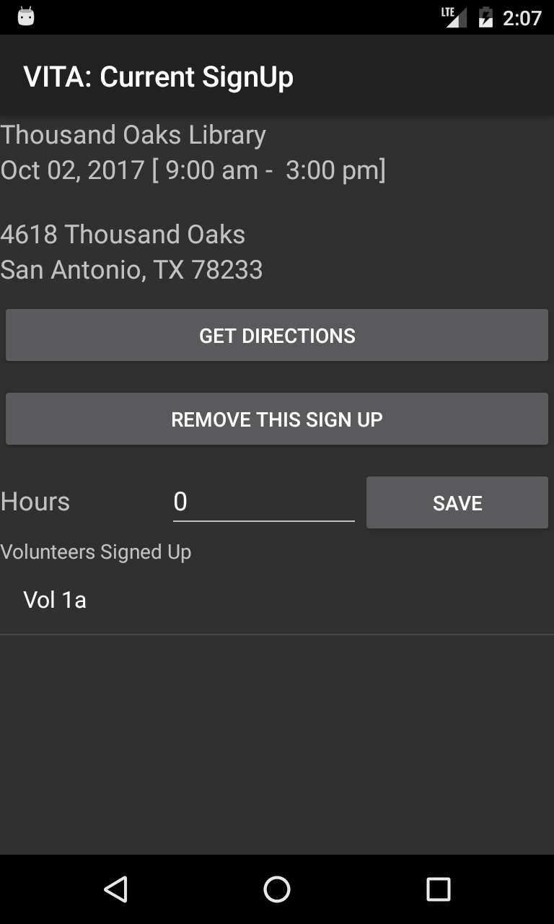

Slide 52
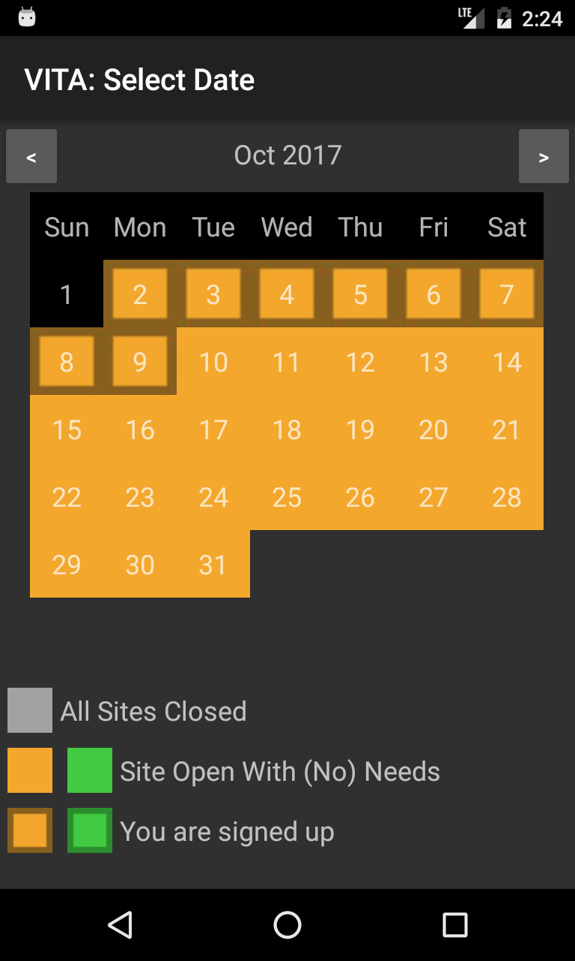

Slide 53
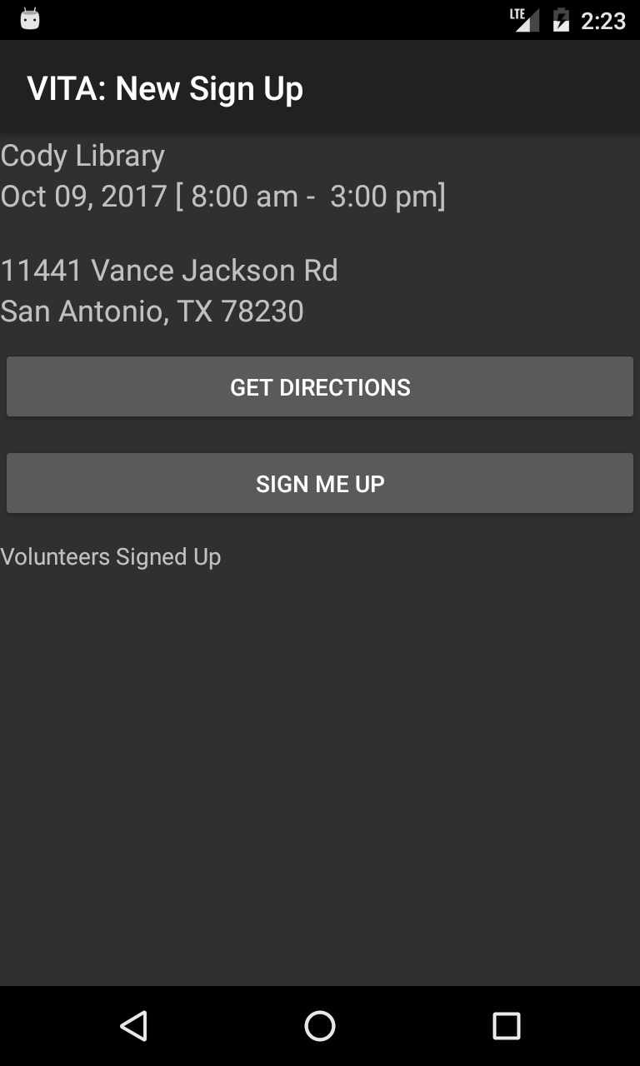

Slide 54
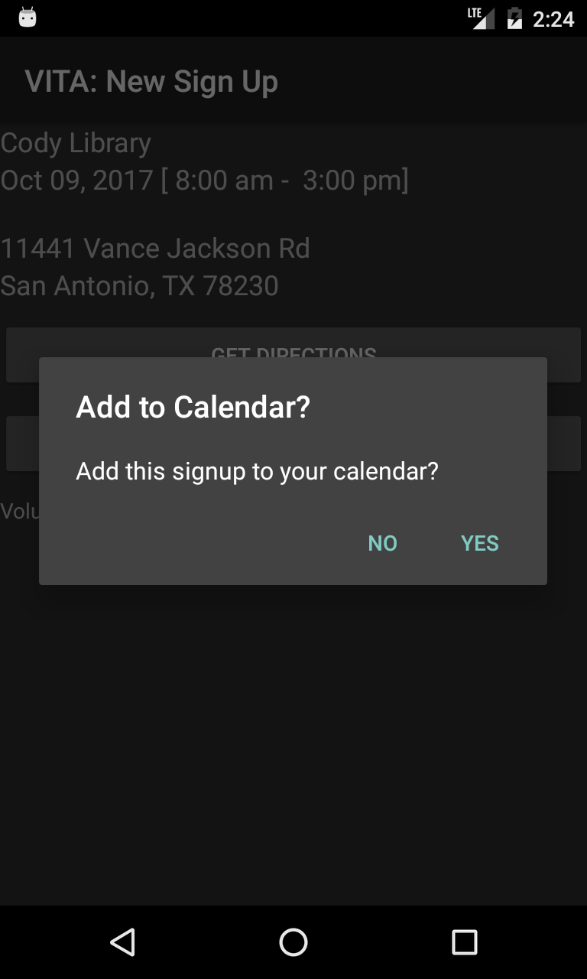

Slide 55
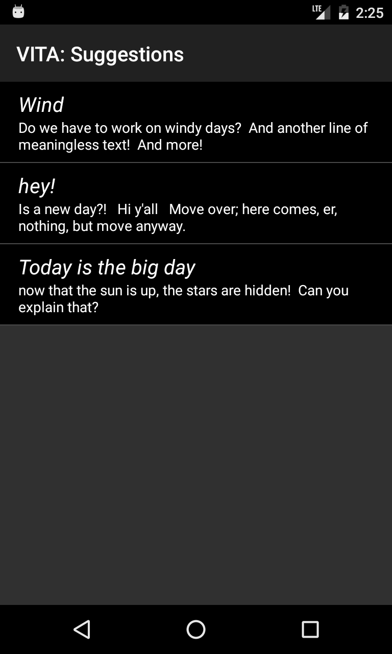

Slide 56
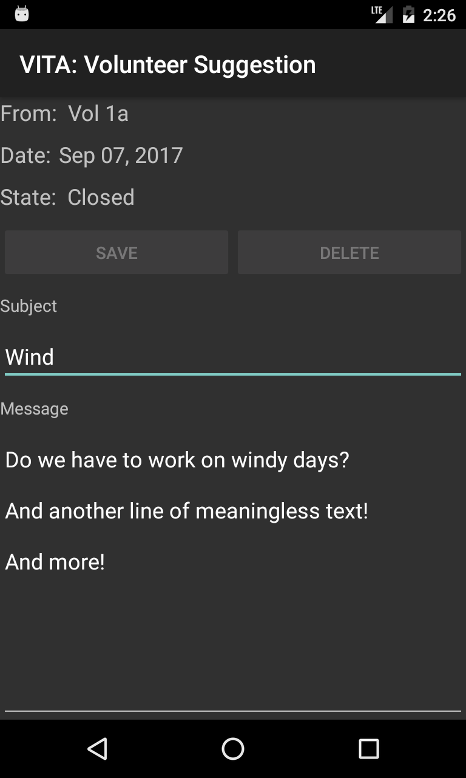

Slide 57
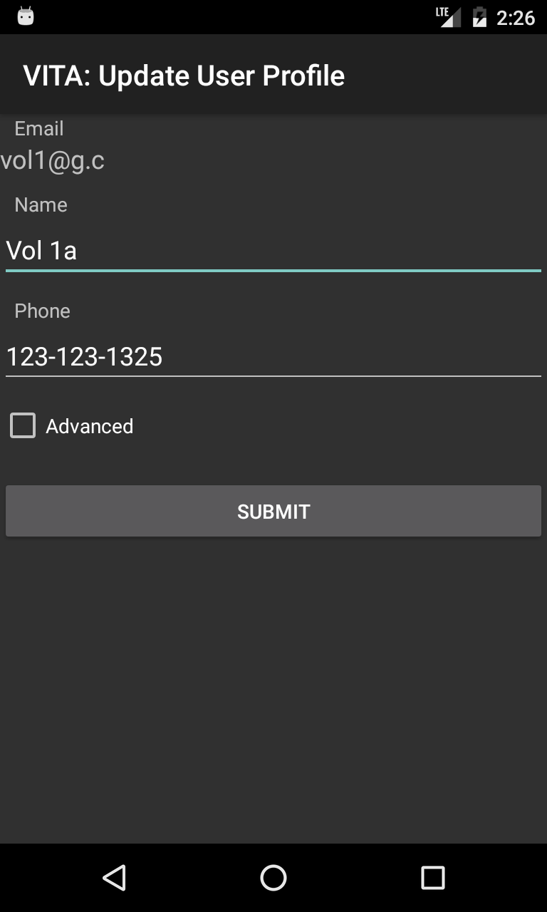

Slide 58

VITA SA App
Volunteer Management
For iPhone and Android phones
Encourage volunteers to go to the sites that need help.
(and away from sites that don’t)
Optimize the customer experience by fully utilizing staff, sites, and volunteers.

